Slide 1
Theories of Motivation

Slide 2
Learning Goals
Outline the main features of Taylor's theories of Motivation.
Outline the main features of Maslow and Hertzberg's' theories of Motivation.

Slide 4
Motivation
Motivation – what is it?
The cause of people's actions – why people behave as they do.
Motivation Theory – what is this?
The study of factors that influence the behavior of people in the workplace.

Slide 5
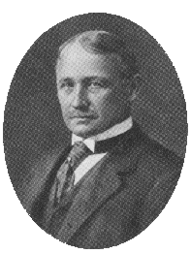
F.W. Taylor’s Scientific Management
F.W. Taylor (1856 – 1915) was an American engineer who invented work-study and founded the scientific approach to management
He considered money to be the main factor that motivated workers, so he emphasised the benefits of Piece Work.

Slide 6
F.W. Taylor’s Scientific Management
Scientific Management – Business decision making based on data that are researched and tested quantitatively in order to improve efficiency of an organization.
Higher efficiency would generate higher profits and thus higher wages to workers.
Taylor saw Humans as Machines

Slide 7
F.W. Taylor’s Scientific Management
Taylor recommended:
Extreme division of labor (with workers specializing in one very narrow task)
Payment by piecework
Tight management control
Division of labour – breaking a job into small repetitive tasks, each of which can be done at a speed with little training.
Piecework – Means payment by results, e.g. per item produced.
Tight management ensures the workers concentrate on their jobs and follow the correct processes.

Slide 8
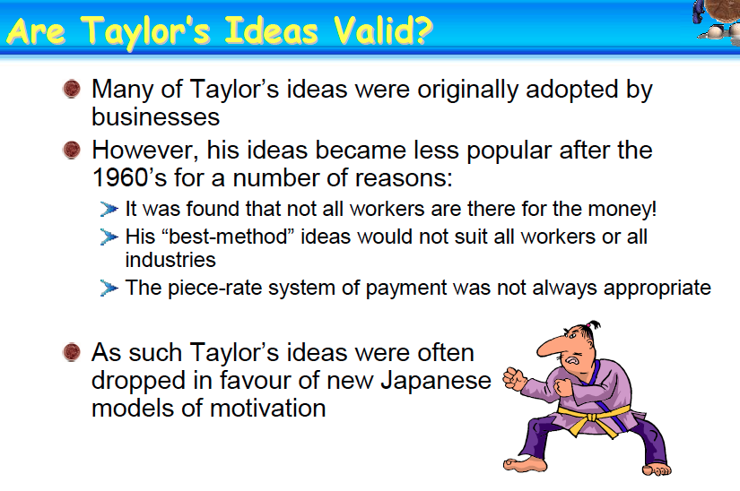

Slide 9
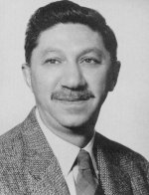
Maslow’s Hierarchy of Human Needs
Abraham Maslow (1908 – 1970) was an American psychologist whose work on human needs has had a major influence on management thinking.
His Hierarchy of Needs suggests that people have similar types of needs from low level basic to the need for achievement.

Slide 10
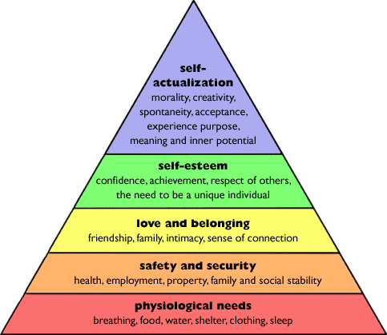
Maslow’s Hierarchy of Needs

Slide 11
Maslow’s Hierarchy Needs
Once a need was satisfied, the next level of unsatisfied need became a motivator, and if employees didn’t have access to gain those needs then it would lead to de-motivation. This theory is appealing but some key issues were raised:
Do all Humans have the same set of needs?
Do different people have different degrees of needs?
Can anyone’s need ever be said to be fully satisfied?

Slide 12
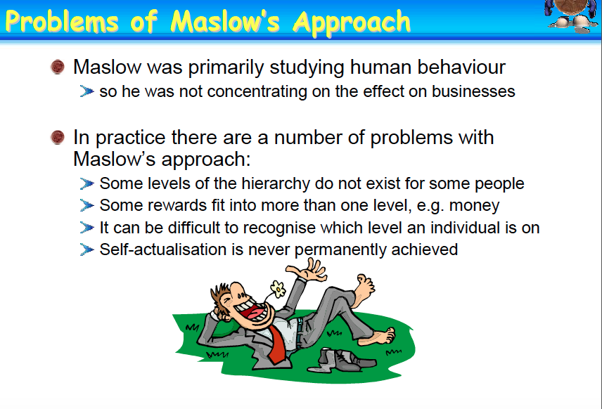

Slide 13
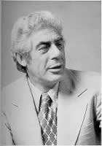
Herzberg’s two factor theory
Frederick Herzberg (1923-2000) was an American psychologist whose research led him to develop the Two-Factor theory of job satisfaction and dissatisfaction.
He suggested some factors had the potential to give job satisfaction (Motivators) and some factors can reduce job satisfaction (Hygiene or maintenance factors).

Slide 14
Herzberg’s two factor theory
Motivators | Hygiene / Maintenance Factors
Sense of Achievement | Working Conditions
Recognition for effort & achievement | Supervision
Nature of the work itself | Pay
Responsibility | Interpersonal relations
Promotion & improvement opportunities | Company policy and Admin, inc paperwork, rules, red tape

Slide 15
Herzberg’s two factor theory
All of the motivators concern the job itself rather than issues such as pay, and all are likely to motivate workers and improve productivity.
All of the Hygiene factors ‘surround’ the job: they do not concern the job itself, ensuring that they are acceptable to the workforce prevents dissatisfaction rather than causing motivation.

Slide 16
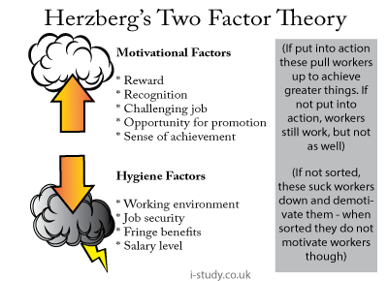

Slide 17
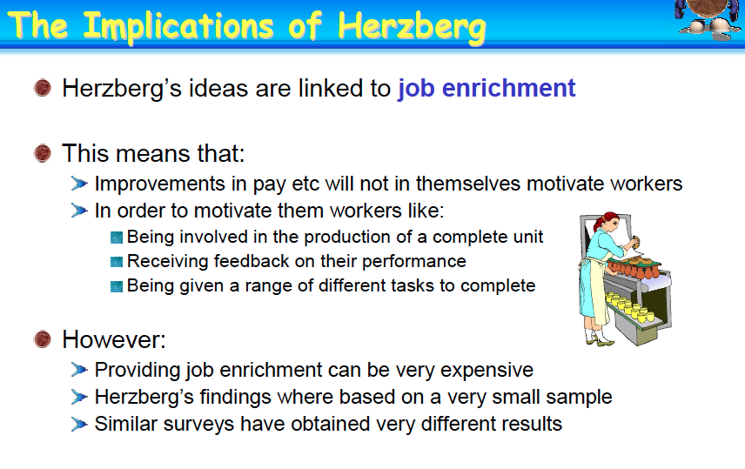

Slide 18
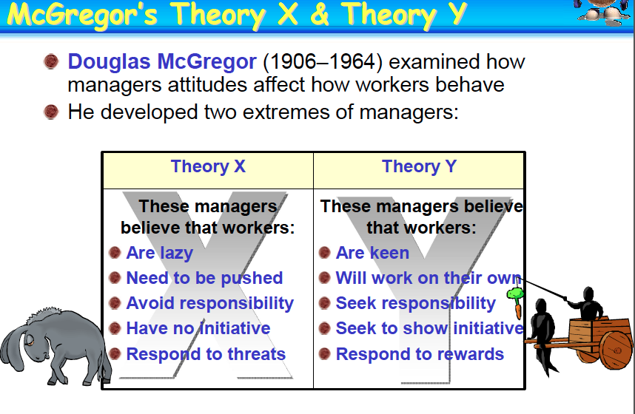

Slide 19
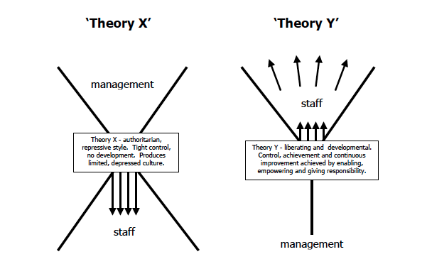

Slide 20
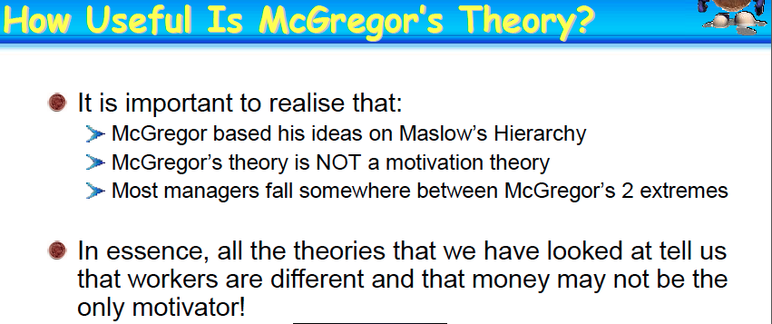

Slide 21
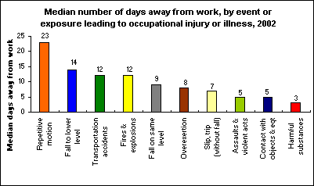
How Useful are Theories of Motivation?
The answer depends on the work situation
Traditional manufacturing organisations with an authoritarian approach, a tall hierarchy and routine and monotonous work may find that money is a great motivator – This supports Taylor’s view. Ensuring that Herzberg’s hygiene or maintenance factors are appropriate.

Slide 22

How Useful are Theories of Motivation?
In organisations with a large number of highly skilled workers, pay rates and working conditions are important, but workers expect more recognition, self-control, involvement in decision making and empowerment. (Maslow higher level needs and Herzberg motivators)

Slide 23

How Useful are Theories of Motivation?
Motivation DOES increase efficiency.
Organisations will benefit from motivated employees.
All theories are to some extent useful in helping organisations achieve this.

Slide 24

Activity 1“What does a IFY Student need?”
In groups, list the needs of a IFY student.
Then categorise them all into the 5 levels of needs according to Maslow’s Theory.
Students present their answers on a pyramid on A3 paper
10 minutes

Slide 25
Activity 2
Name the employees’ 5 levels of needs according to Maslow’s hierarchy theory in the business you looked at at the start of this section.
Students are required to propose strategies to
motivate the staff to improve the job performance based on the theories.
students to present their answers .
15 minutes

Slide 26
Activity 3
: “Joseph’s Unhappy Experience”
the background of the case.
In groups complete the tasks.
- Task 1: identify the factors which are absent or
inadequate that making Joseph feel dissatisfied
with his job.
- Task 2: Suggest ways to improve Joseph’s job
dissatisfaction; and to motivate Joseph
to improve his job performance.
 Students present their answers.
15 minutes

Slide 27
Activity 4
Complete Motivating statements worksheet
10 minutes

Slide 28
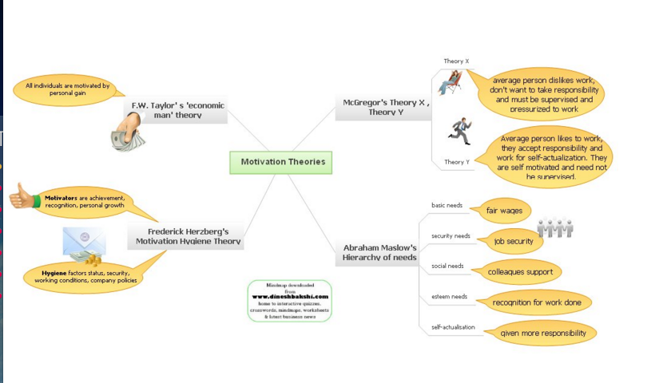
This weeks graphic organiser
Mind Map of Motivational Theories

Slide 29
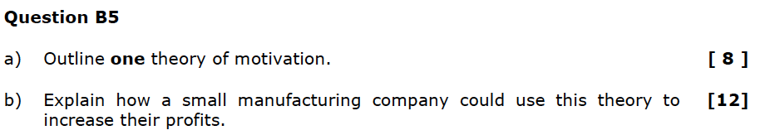
Homework Exam Practice:
Section B 2013/14

